Slide 1



A decoy-free approach for identifying peptides in metaproteomics
department biomolecular medicine
research group Compomics
Defense Research Proposal / Wout Cattrijsse / 27.06.2023
Notes:
Hi everyone, I am Wout, and I am here this morning to present my research proposal about “A decoy-free approach for identifying peptides in metaproteomics” to you.

Slide 2
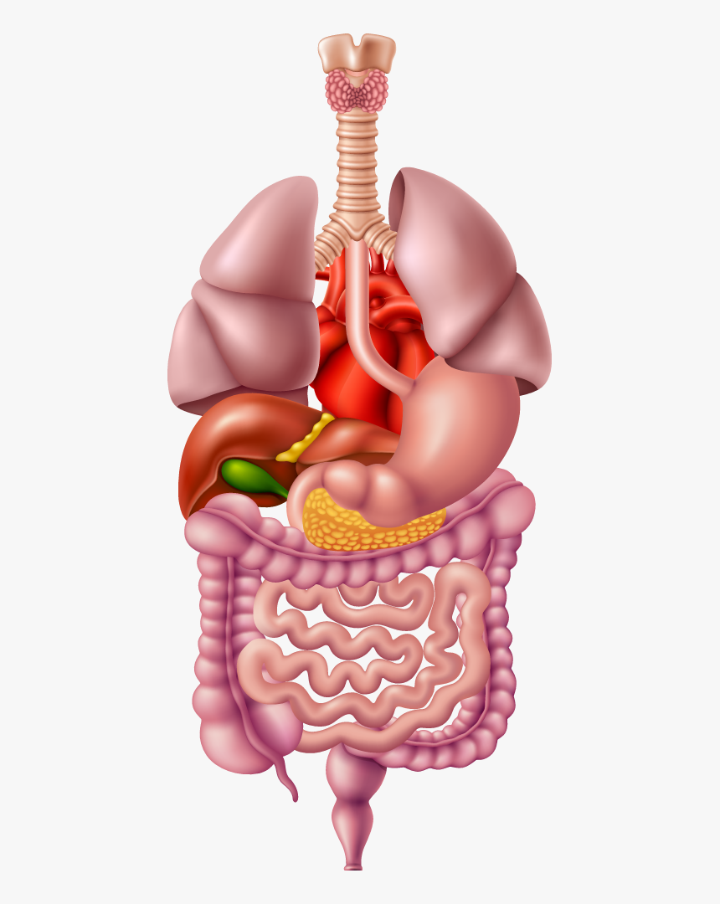
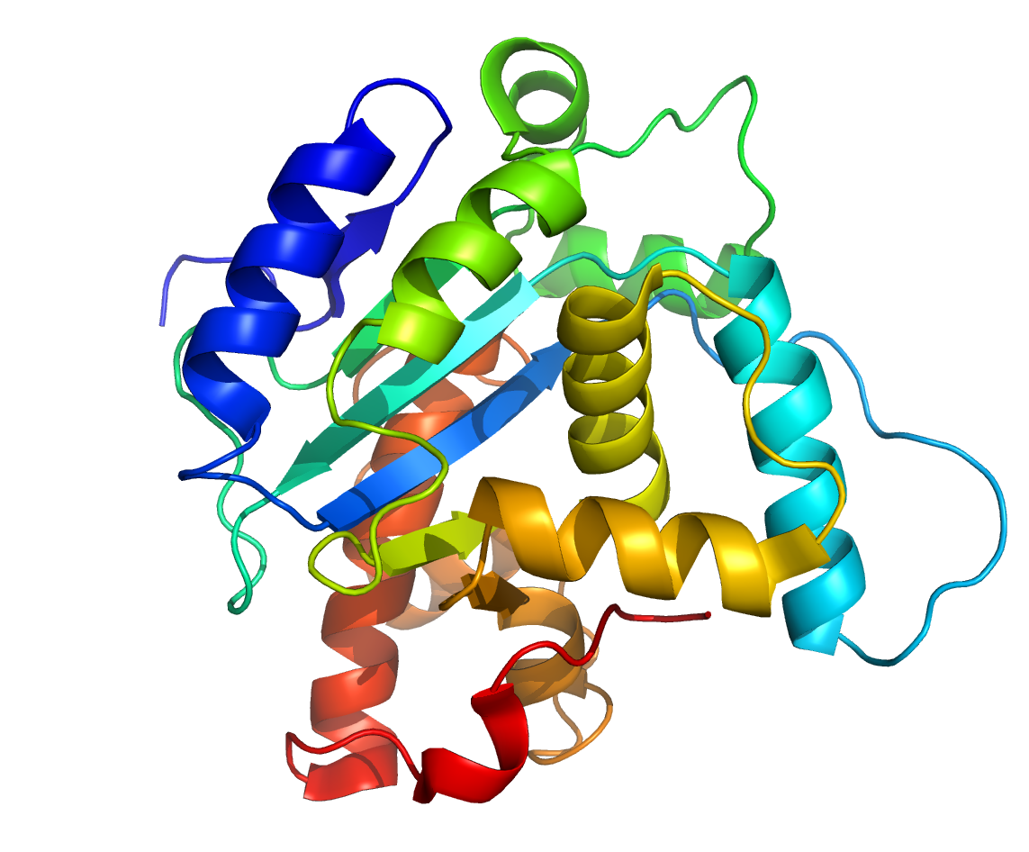
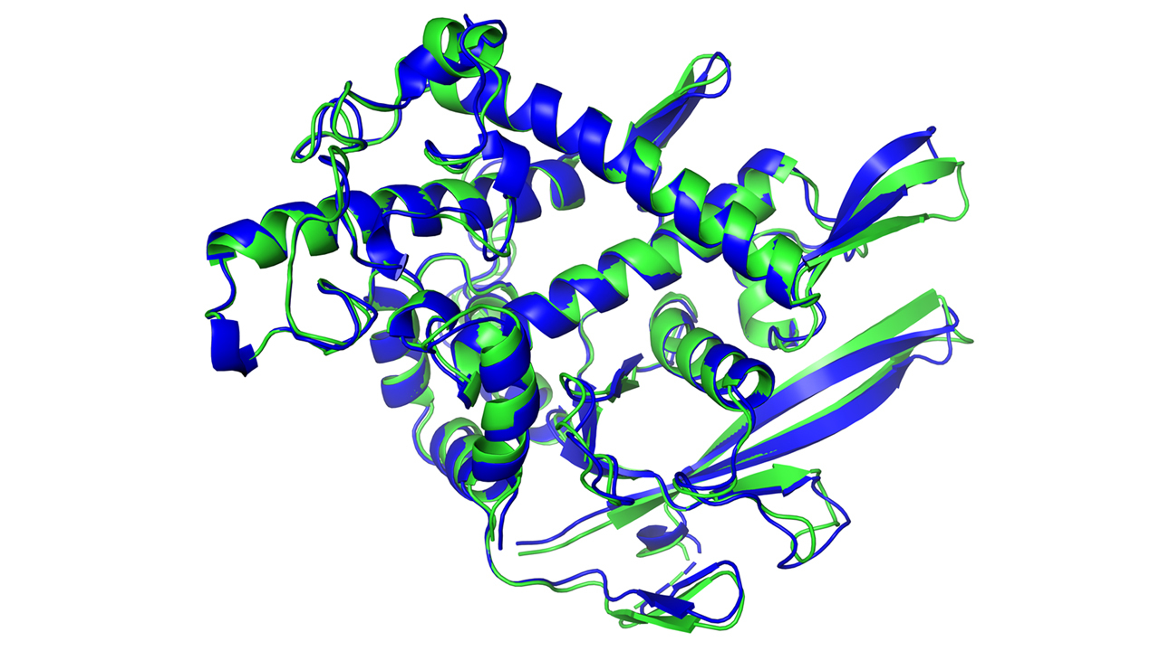


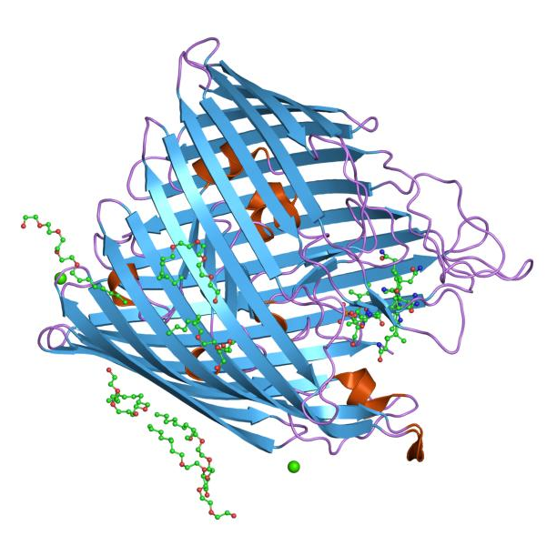



Metaproteomics aims to understand the functional activities of microbial communities
Microbial community
Applications
Human health
Gut microbiome
Full protein complement
Ocean & soil microbiome
Environmental science
Notes:
Metaproteomics is defined as “the large-scale characterization of the entire protein complement of environmental microbiota at a given point in time.” These environmental microbiota can be found in many different places such as the human gut with the gut microbiome or in the ocean or in soil. The goal is then to study the full protein complement present in such communities to study their functional aspects. These metaproteomic studies then give us a lot of insights into different applications such as human health and environmental science.

Slide 3
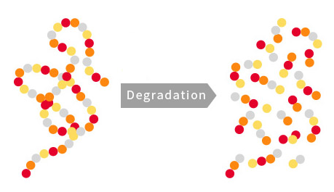
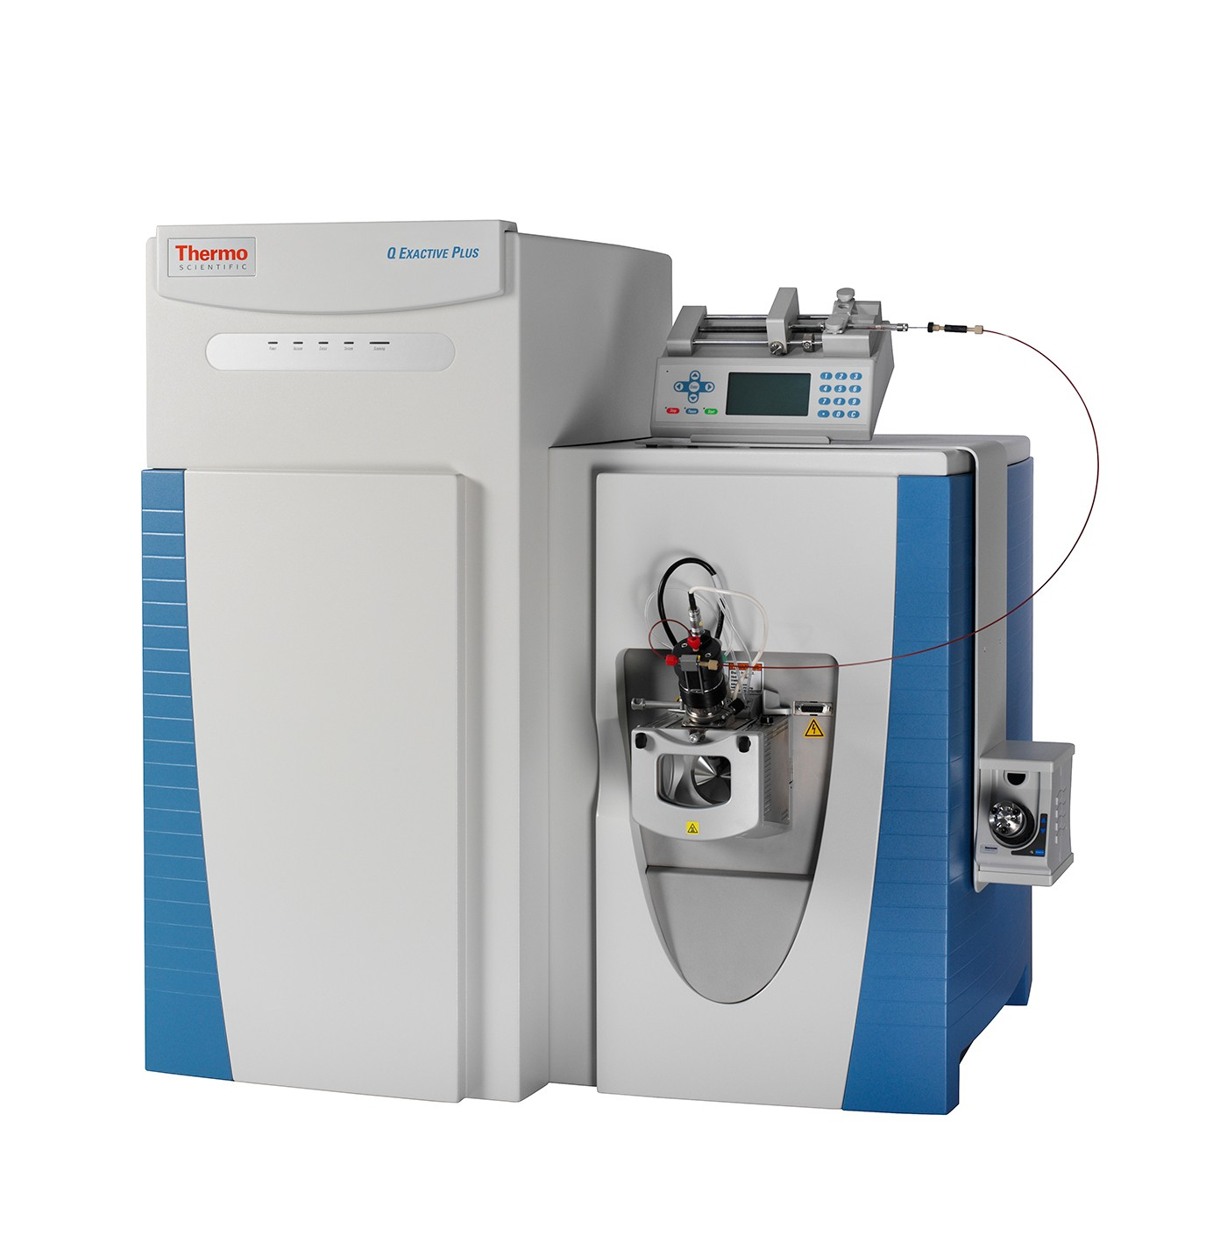
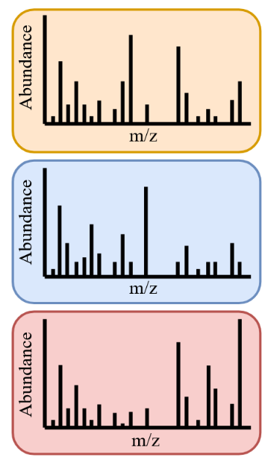
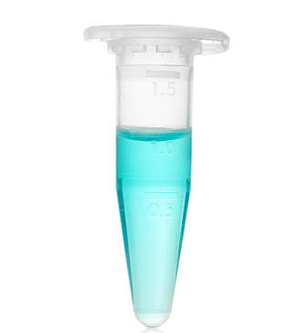
Bottom-up proteomics is the most common way of studying proteins
Sample
Protein
Peptide
LC-MS/MS
Experimental fragmentation spectra
Notes:
Now the most common way of studying proteomics is by means of bottom-up proteomics in which we start with our sample from which we extract the proteins which are digested into peptides which are then loaded onto a liquid chromatography column coupled to a mass spectrometer. From this we can eventually read out the experimental fragmentation spectra.

Slide 4


Bottom-up proteomics is the most common way of studying proteins
Sample
Protein
Peptide
LC-MS/MS
Experimental fragmentation spectra
Peptide identification +
protein inference
Search engine
Protein database
In silico digested peptides
Theoretical fragmentation spectra
Notes:
By using a protein database, we can generate in silico digested peptides and from these in silico digested peptides, theoretical fragmentation spectra are generated. The experimental fragmentation spectra are then compared against these theoretical fragmentation spectra using a search engine to identify the peptides that are present in the sample. From these peptides the proteins are inferred.

Slide 5
The big databases used in metaproteomics complicate this procedure
Sample
Protein
Peptide
LC-MS/MS
Experimental fragmentation spectra
Peptide identification +
protein inference
Search engine
In silico digested peptides
Theoretical fragmentation spectra
Protein database
Notes:
However in metaproteomics, since we want to study a whole microbial community at once, we need databases that are a lot bigger in order to capture the high complexity and variability of the sample.

Slide 6
The big databases used in metaproteomics complicate this procedure
Sample
Protein
Peptide
LC-MS/MS
Experimental fragmentation spectra
Peptide identification +
protein inference
Search engine
In silico digested peptides
Theoretical fragmentation spectra
Protein database
Notes:
These larger protein databases naturally come with an increased amount of in silico digested peptides and thus a lot more theoretical fragmentation spectra. This complicates the analysis of metaproteomic data.

Slide 7
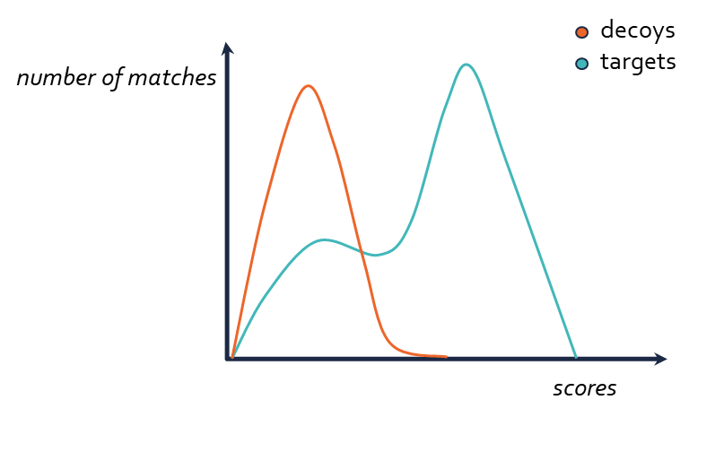
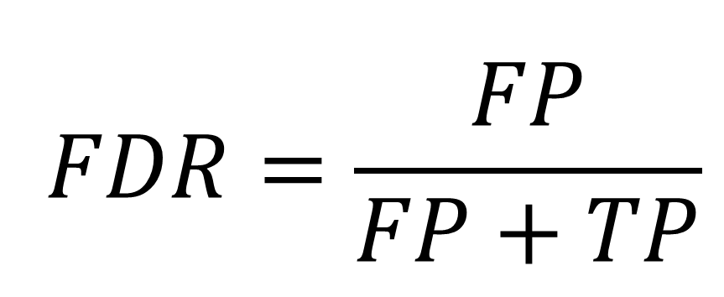
The target-decoy approach (TDA) is the most commonly used method for estimating the FDR
(target) PEPTIDEK vs. (decoy) EDITPEPK
$$FDR=\frac{FP}{FP+TP}$$
Notes:
When working with proteomics data in general we always need to be able to distinguish bad hits from good hits. For this purpose the False Discovery Rate is used. This is effectively a threshold that determines statistical significance. This FDR is estimated by controlling the proportion of false positives among all significant results, which is shown in this formula.

Slide 8
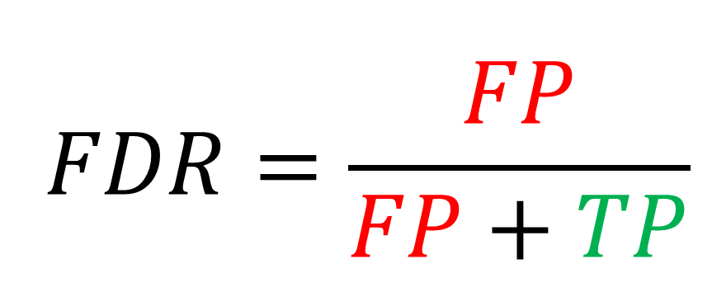
The target-decoy approach (TDA) is the most commonly used method for estimating the FDR
(target) PEPTIDEK vs. (decoy) EDITPEPK
$$FDR=\frac{FP}{FP+TP}$$
Notes:
This can be nicely visualized in this figure where the FDR threshold is visualized by this line, and this is usually set at 1%, meaning out of all significant results only 1% will be false positives. So here the false positives are indicated in red and the true positives are indicated in green.
The most popular way of estimating the FDR is the target-decoy approach. Here the target database is concatenated with a decoy database which contains reversed or shuffled versions of the target protein sequences. This concatenated database is used during the peptide identification and since the decoy database contains shuffled or reversed proteins, all hits against these sequences can be considered false positives. We can then analyse the proportion of decoy hits over target hits to estimate the FDR.
So if we then return to this figure over here we can see that the orange curve shows the distribution of the decoy hits, being our false positives, and the green curve shows the distribution of the target hits, our true positives.

Slide 9
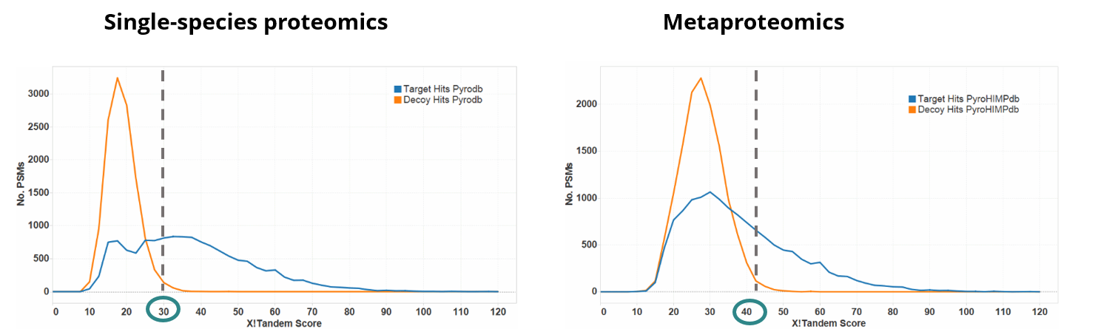
Problem: the large databases in metaproteomics cause a big overlap in target-decoy score distributions
(10K proteins)
(6,1M proteins)
Adapted from Muth, T. et al., 2015 PROTEOMICS. ,
Notes:
However, in metaproteomics we encounter an issue here. Because of the large databases that are used, the target and decoy sequences will become too similar causing their score distributions to overlap too much with a low identification rate as a result. This has been visualized in these two graphs. The graph on the left-hand side shows a single-species proteomics experiment where a database of 10 000 proteins was used and the graph on the right shows a metaproteomics experiment where a protein database of 6,1million proteins was used. In the single species proteomics experiment we can see the distribution of the target hits in blue and the decoy hits’ distribution in orange. These two distributions are nicely separated and the FDR threshold is at an X!Tandem score of 30. So here we clearly have a lot of identifications. In the metaproteomics experiment the distributions of the target hits, in blue, and the decoy hits, in orange, are clearly overlapping a lot more. Because of this the X!Tandem score, given our FDR threshold, has shifted from 30 to 40 due to the good decoy scores.

Slide 10
Problem: the large databases in metaproteomics cause a big overlap in target-decoy score distributions
(10K proteins)
(6,1M proteins)
IDENTIFICATION RATE DECREASES
Adapted from Muth, T. et al., 2015 PROTEOMICS. ,
Notes:
Because of this, if we want to maintain the same FDR threshold, we end up with a much decreased identification rate.

Slide 11
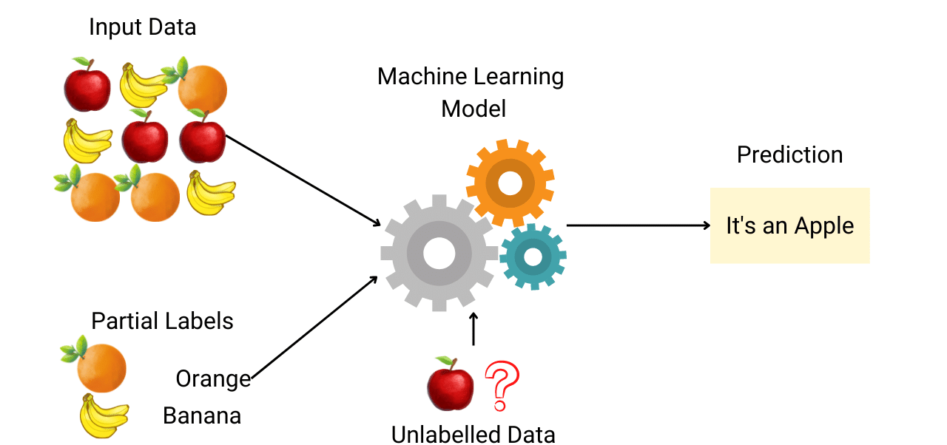
Solution: develop a decoy-free semi-supervised machine learning model
Notes:
In my thesis, I will tackle this problem by applying a decoy-free approach using a semi-supervised machine learning model. A semi-supervised machine learning model works by first giving a small dataset with labels added to the data for the model to be fitted on. After training on the small dataset, the model can train itself on the rest of the unlabelled data and add the accurately identified datapoints to the labelled dataset to train itself again. This iterative process is repeated until a specified accuracy or certain number or iterations is reached.

Slide 12
The binary classifier Nokoi can be used as a template for this model
All PSMs output from the search engine
It’s a good hit!
Rank 1 PSM-based feature vector
Good hit
High scoring PSM
Low-ranked PSM based feature vector
Bad hit
Notes:
A similar set-up has already been employed in the binary classifier Nokoi. Nokoi is a supervised machine learning model that uses the low-ranked PSMs as substitutes for decoy PSMs. From these low-ranked PSMs several features were extracted, and these were used to compute a feature vector that serves as the negative example. For the positive example a feature vector was calculated in the same manner but using the highly confident rank 1 PSMs. We can then use the same idea in a semi-supervised set-up as is visualized here.

Slide 13
The goal is to design an alternative strategy to the TDA approach in metaproteomics to obtain a higher identification rate and lower computation time
Notes:
Now putting all this information together, I can come to the overall objective of my thesis. The goal is to design an alternative strategy to the TDA approach in metaproteomics which obtains a higher identification rate and lower computation time. But now the question remains: “How will I do this?”.

Slide 14


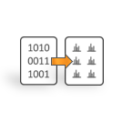

Data collection & processing
TDA & two-step reinvestigation
Model training & validation
CAMPI study
Van Den Bossche T. et al.
+
Biologically relevant datasets
Notes:
This is where my work plan comes in. I will start by collecting metaproteomic data from the PRIDE database, I will also retrieve the benchmarking datasets provided by the CAMPI study. I will then process this data to be in the MGF format using ThermoRawFileParser.
Then I will reinvestigate the target-decoy approach and also an alternative method to raise the identification rate in metaproteomics, namely the two-step search method. I will do this by performing both of these methods on the benchmarking datasets of the CAMPI study. The results obtained in this step can then later serve as a comparison against the decoy-free method that I will design. So these CAMPI datasets will serve as validation datasets for the model.
Then I can continue to the actual model training and validation. The code for this project will be written in Python with Nextflow as the workflow framework used to build and execute the data analysis pipelines. The model validation can be performed on the CAMPI benchmarking datasets, as stated before.

Slide 15
Contribution to the field & societal impact
(10K proteins)
(6,1M proteins)
IDENTIFICATION RATE INCREASES
Adapted from Muth, T. et al., 2015 PROTEOMICS. ,
Notes:
As a final remark I would like to say a few words about how I think this could make a contribution to the field and eventually even have an impact on society as a whole. If this model would effectively produce the results I am hoping for we would be able to more accurately and efficiently characterize metaproteomic samples which could benefit the whole field.

Slide 16
Metaproteomics aims to understand the functional activities of microbial communities
Microbial community
Applications
Human health
Gut microbiome
Full protein complement
Ocean & soil microbiome
Environmental science
Notes:
On the societal level, as I said in the beginning, metaproteomics has a lot of applications in the real world such as human health and environmental science. If we can better understand the functional aspects of microbial communities, these fields could definitely benefit from this.

Slide 17



Wout Cattrijsse 1st Master Biomedical Sciences Compomics E wout.cattrijsse@ugent.be www.ugent.be
Universiteit Gent @ugent
@ugent Ghent University
Notes:
That was all I have for you today, thank you for your attention and if there are any more questions I will be glad to answer them.

Slide 18
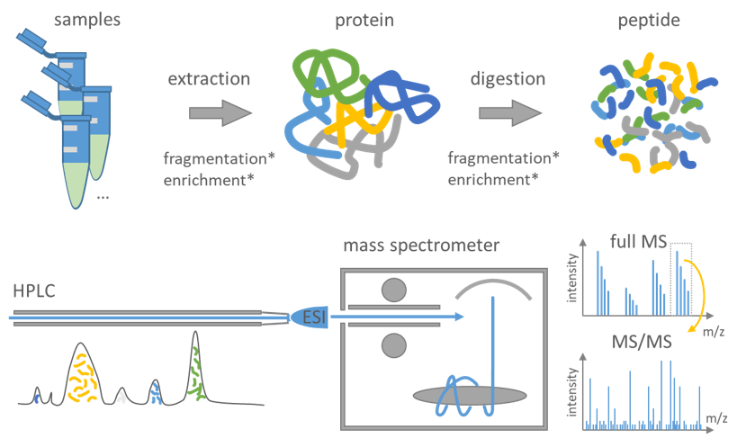
Basic Mass Spectrometry Workflow
Comparison with in silico generated spectra
+
Peptide identification and protein inference
Figure adapted from: https://csbiology.github.io/BIO-BTE-06-L-7/NB02a_Mass_spectrometry_based_proteomics.html#NB02a-Mass-Spectrometry-Based-Proteomics

